Slide 1

LiftLog
Logging them lifts, cataloging those gainz
THE HIGH FIVE
David Ralston Scrum master
Ishan Pathirana
Rahul Arora Project Owner
Scott Zin
Yotam Golan

Slide 2

Lift Log
Get Fit
Track Progress
Custom Workouts
Intuitive Interface
Workout Guidance
Pre-planned programs

Slide 3

Scope
Custom Profile
Build and Track Workouts
Workouts are Sets of Exercises
Exercises can be Compiled to Custom Workouts
Progress is Tracked and Suggestions Made

Slide 4

SPRINT 1
Initial Commit
Design Login Page
Design Profile Page
As a User, I want to:
Login
Create/edit my profile

Slide 5

SPRINT 2
As a User, I want to
See pre-made workouts
Select pre-made workouts
Navigate to different areas of the application
Design Workout Page
Design Exercise Page

Slide 6

SPRINT 3
As a User, I want to:
Track my workout progress/ accomplishments
See body/workout statistics
See workout modification suggestions
Transfer information between devices

Slide 7

SPRINT 4
As a User, I want to:
See a selection of available exercises
Compile exercises into a workout
Share a custom workout
Rate community created workouts

Slide 8
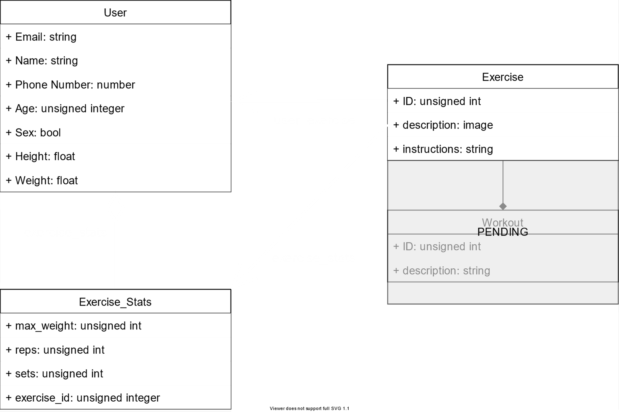
Architecture

Slide 9












Technologies
Languages
Project Management
Development Environment
Database
Design/Presentation

Slide 10

Unfamiliar technology
Potential feature creep
UX/UI design
Challenges

Slide 11
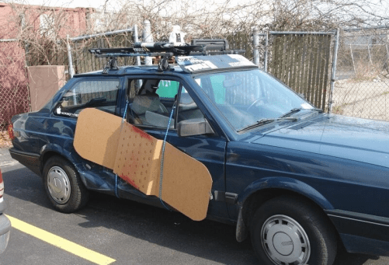
Minimum Viable Product
As a User I will be able to:
Login and edit my profile
Select and track a pre-made workout
Monitor progress

